Slide 1

Department of Computer Science and Engineering
Analysis and Prediction of Occupational Accidents
Date: 28 May 2021
K. Kavya : 17WH1A0532
M. Nikhila Shinu : 17WH1A0552
V. Hari Chandana : 17WH1A0515
G. Sravani : 18WH5A0509
Internal Guide : Mr. C Naga Raju
Designation : Assistant Professor

Slide 2


Abstract
Why Should I Study this course?
Examples
BVRIT HYDERABAD College of Engineering for Women
Workplace safety is a major concern in many countries. Among various industries, construction sector is identified as the most hazardous workplace. Construction accidents not only cause human sufferings but also result in huge financial loss. To prevent reoccurrence of similar accidents in the future and make scientific risk control plans, analysis of accidents is essential.
The main aim of the proposed system is to provide safety to workers at construction site from accidents by analyzing past accident data by using machine learning algorithms and text mining technique.

Slide 3

Architecture
Why Should I Study this course?
Examples
BVRIT HYDERABAD College of Engineering for Women
Data Source
Data Cleaning
Data Preprocessing
Data Analysis
Applying Classifiers/models
Evaluation of models
Prediction
Output

Slide 4
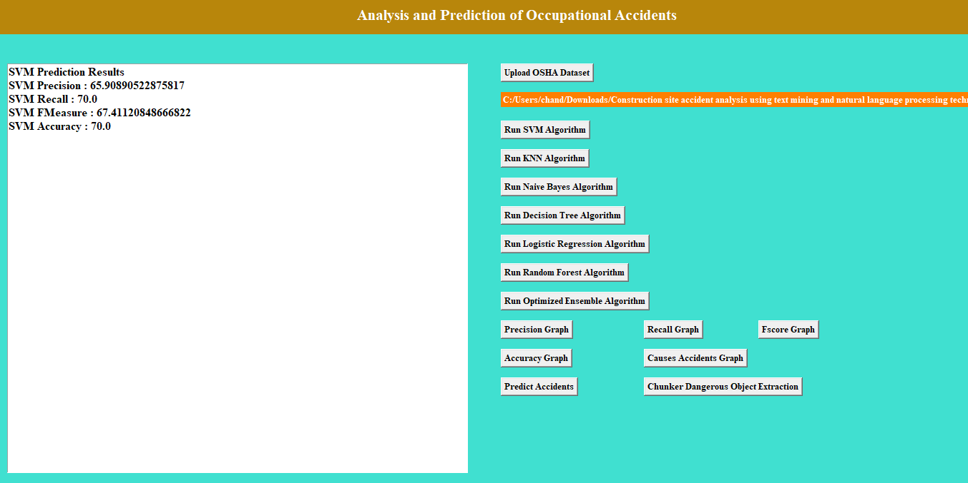
Implementation Output

Slide 5
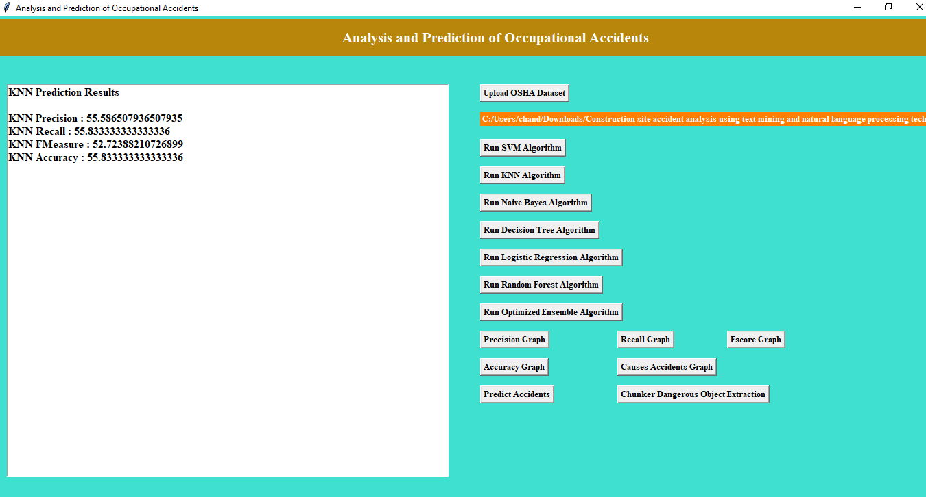

Slide 6
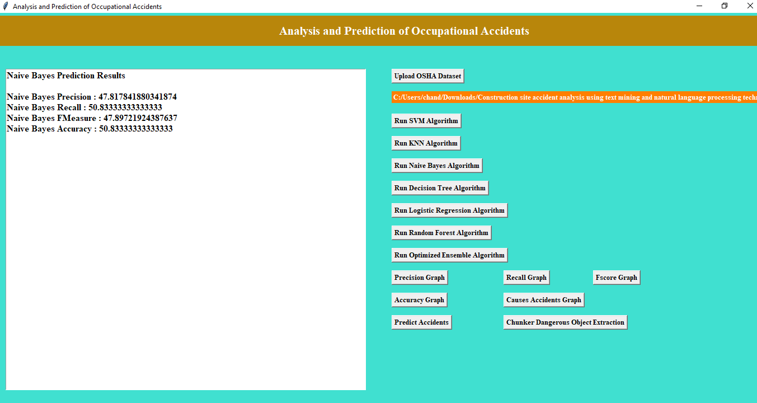

Slide 7
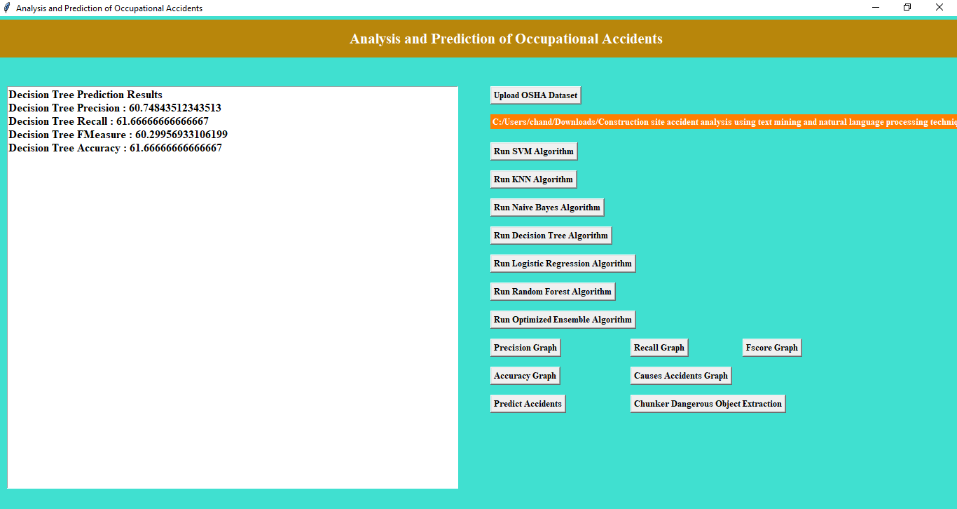

Slide 8
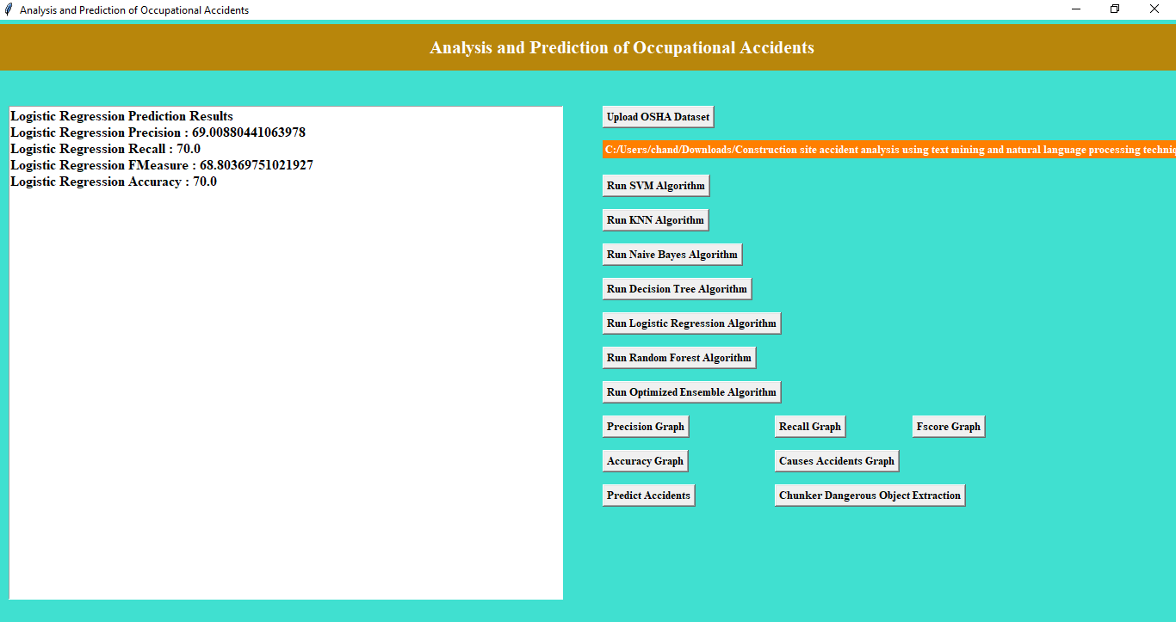

Slide 9
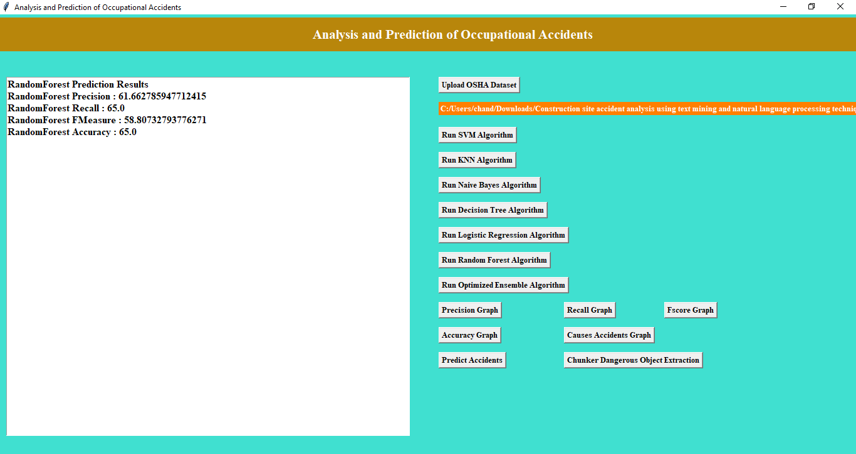

Slide 10
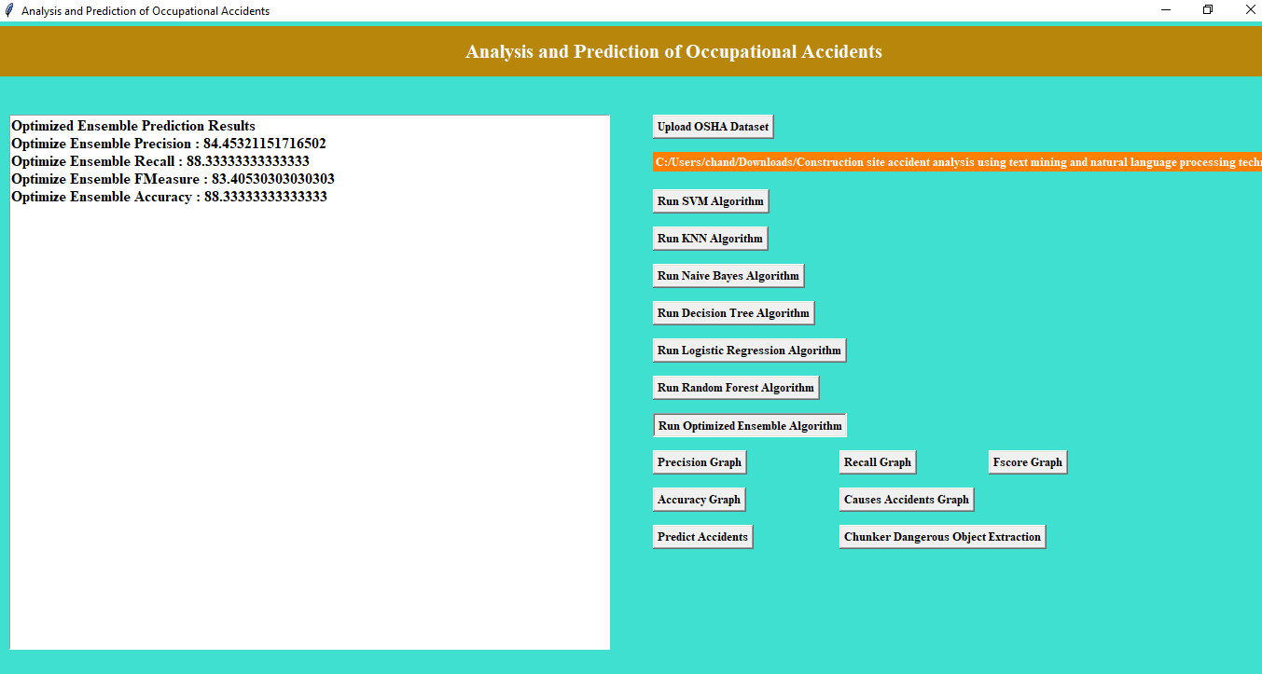

Slide 11
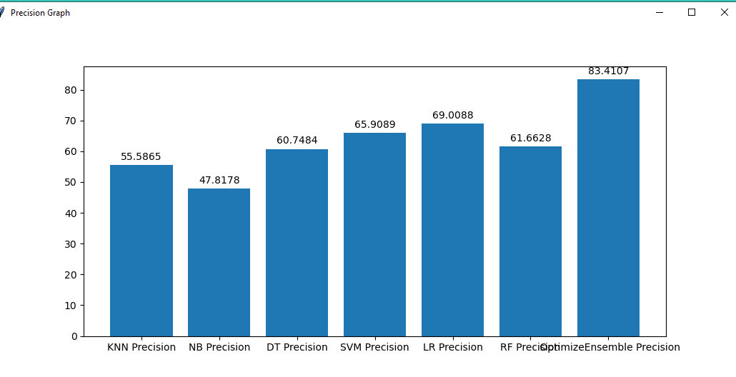
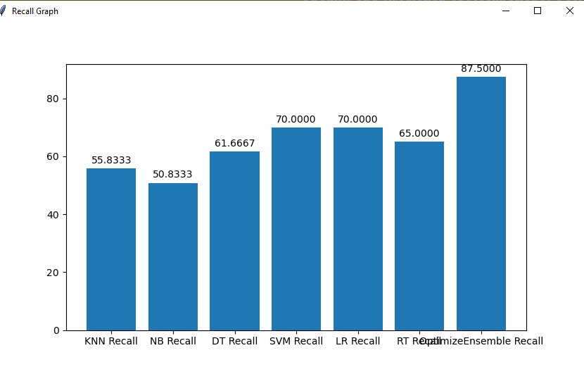

Slide 12
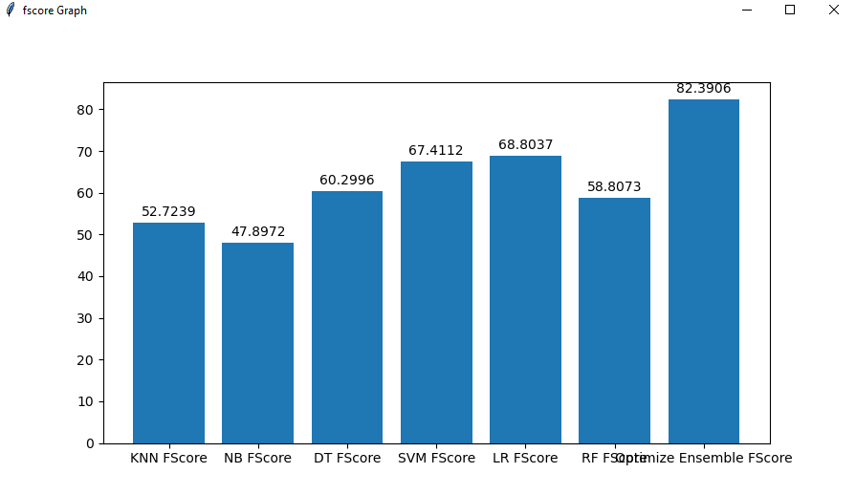
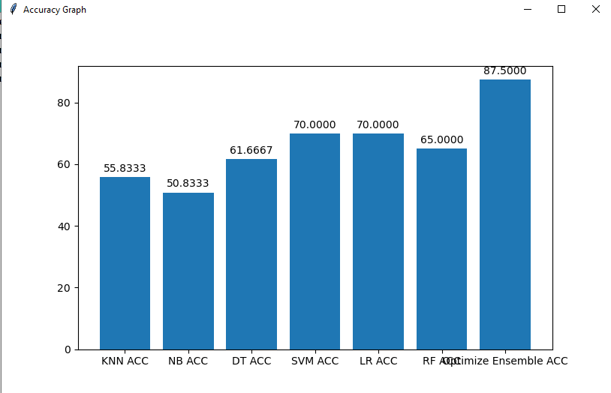

Slide 13
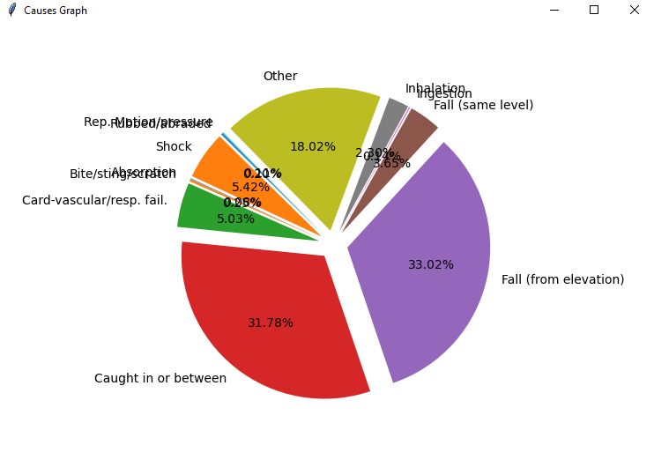

Slide 14
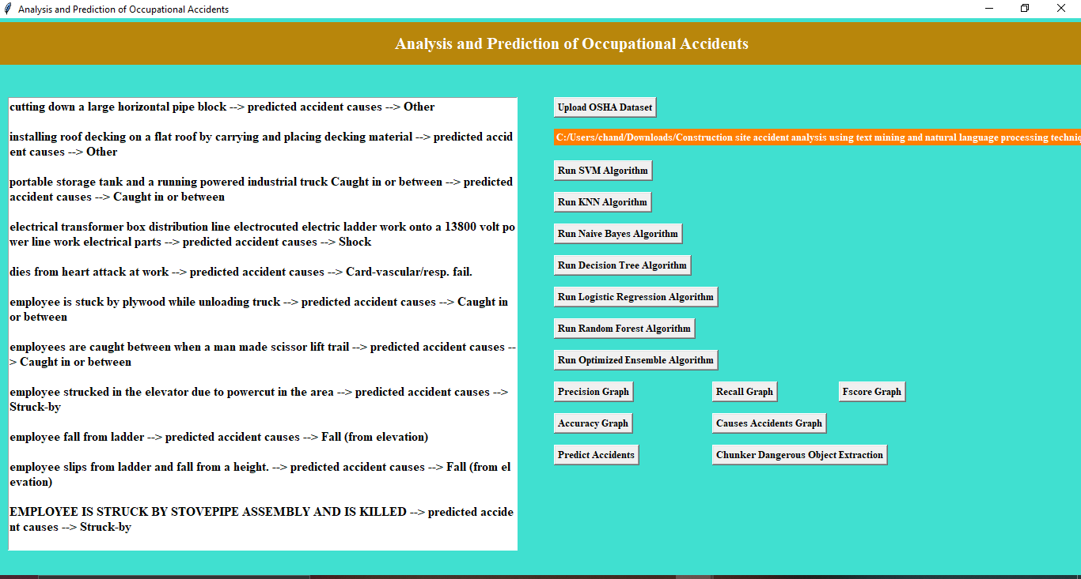

Slide 15
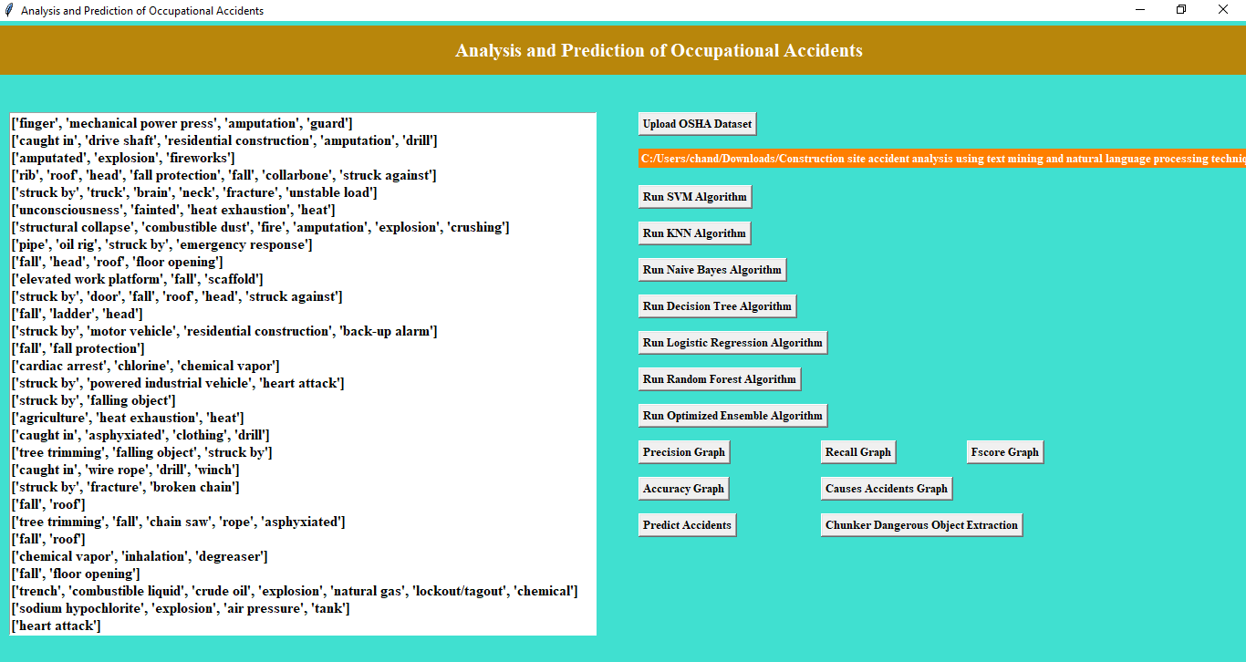

Slide 16
References
Why Should I Study this course?
Examples
BVRIT HYDERABAD College of Engineering for Women
Base paper
https://drive.google.com/file/d/1RxbXio-BwYBT4k8pTsy3oVyZCtHTPi2i/view?usp=sharing
Reference papers
https://www.researchgate.net/publication/315644460_Prediction_of_Occupational_Accidents_Using_Decision_Tree_Approach
https://lib.dr.iastate.edu/cgi/viewcontent.cgi?article=8629&context=etd

Slide 17
Thank you

